Slide 1
Overview of MED676
Part of the MSc in Genomic Medicine

Slide 2
Lecturers
Win Hide
Matthew Parker
Eran Elhaik
Dennis Wang
Janine Kirby
Natalie Groves
Lucy Crooks
Steve Wood

Slide 3
How to get your grade
Personal project presentation – 35%
Project proposal write-up – 50%
Three lab quizzes - 15%

Slide 4
Quizzes
Three quizzes will be administered through Google Forms during the module classes, one on each day: Jan 23, 24, and 25th.
These will examine concepts taught in the online video lectures and through the in class practicals.
Solutions and feedback will be provided the following day of each quiz.

Slide 5
Presentations
Prepare a pilot grant proposal (due Jan 27th)
Proposal should adhere to guidelines in proposal outline document.
Presentation should discuss (1 slide per section) - 5 slides, 5 minute presentation. Followed by 1-2mins of questions.
technology approach for sequencing
choice of methods for analysis to include variant calling and ﬁltering approach
example of a ﬁle generated from a chosen dataset and justiﬁcation of dataset choice for analysis
interpretation of results to infer clinical outcome
description of adherence to clinical calling standards and best-practice guidelines for reporting the clinical signiﬁcance of analytical results

Slide 6
Write-up
Personal project writeup/proposal - due Monday 5 pm February 27 – worth 50%
(3 pages maximum)

Slide 7
What to expect
This is bioinformatics
It’s science
You are in charge
Genomics England is work in progress
Overload

Slide 8
Day 1 – Intro and alignment
8:30 - 9:00 |  | Welcome and introduction - learning objectives | Win / Dennis
9:15 - 10:00 | L | Introduction to variant analysis using HTS data and its caveats | Dennis
10:00 – 10:45 | L | Introduction to Genomics England, data, data access policy, how GE data is generated | Matt
10:45 – 11:00 |  | Coffee break
11:00 - 12:00 | L/P | Design of studies and clinical trials and how this affects the outcomes | Win
12:00 - 13:00 |  | Lunch + feedback
13:00 - 14:00 | L | Introduction to Galaxy | Eran
14:00 - 15:00 | L / P | Connecting and exploring tools on Embassy | Matt
15:00 - 15:30 |  | Coffee break
15:30 - 15:45 | A | Online quiz on pipelines and Galaxy | Dennis
15:45 - 17:30 | P | Sequence alignment (FASTQ to BAM) and BLAST using Galaxy | Dennis
17:30 - 18:00 |  | Q&A and gathering feedback | Everyone

Slide 9
Day 2 – Variant calling and annotation
9:00 - 9:10 | P | Quiz feedback | Dennis
9:10 - 10:00 | L | Overview of tools for variant calling (e.g. GATK,....) | Dennis
10:00 - 10:45 | L | Cancer bioinformtics - somatic variants | Matt
10:45 - 11:00 |  | Coffee break
11:00 - 12:30 | L/P | Inspect a FASTQ and BAM file, manipulate alignments, assess their quality and focus on the importance of quality control measures for HTS data | Lucy
12:30 - 13:30 |  | Lunch + feedback
13:30 - 13:45 | A | Online quiz on assessing an NGS assay | Dennis
13:45 - 15:30 | L | Variant annotation with established databases: How do we use of multiple databases and in silico tools for intepreting the meaning of a variant and evaluate its pathogenicity | Eran
15:30 - 15:45 |  | Coffee break
15:45 - 16:45 | L | Filtering strategies for variants, in the context of clinical data, and using control data sets | Eran
16:45 - 17:30 | P | Variant annotation practical: understanding formats and working with VCFs | Eran
17:30 - 18:00 |  | Q&A and gathering feedback | Everyone

Slide 10
Day 3 – Variant interpretation
9:00 - 9:10 | P | Quiz feedback | Dennis
9:10 - 10:45 | P | Variant annotation practical: annotating variants with different databases | Eran
10:45 - 11:00 |  | Coffee break
11:00 - 12:00 | L | Integration with clinical information (e.g. electronic health records) | Steve Wood
12:00 - 13:00 |  | Lunch
13:00 - 13:45 | L | Principles of biomedical ontologies (e.g. HPO, SNOMED, ICD) and their use for the annotation of GE clinical phenotypes, importance of semantic interoperability for data integration, HPO and the Monarch Inititive | Win
13:45 - 14:30 | L | Current NGS Pipelines & Best Practice in NHS Diagnostic Laboratories | Matt
14:30 - 14:45 |  | Coffee break
14:45 - 15:00 | A | Online quiz on sequence alignment | Dennis
15:00 - 16:00 | L/P | Variant Interpretation in a Clinical Laboratory (including Best Practice Guidelines) | Natalie/Matt
16:00 - 17:00 | P | Case Study on Interpretation of a Patient's Variants | Natalie/Matt
17:00 - 17:30 |  | Q&A and gathering feedback | Everyone

Slide 11
Day 4 – Downstream analysis and proposal work
9:00 - 9:10 | P | Quiz feedback | Dennis
9:10 - 9:45 | L | Increasing the depth of prognistic and diagnostic information: correlation with molecular signatures data and GWAS data | Eran
9:45-10:45 | L | Step by step open discussion on content required for Clinical project write up and presentations + example | Janine / WIn
10:45 - 11:00 |  | Coffee break
11:00 - 12:00 | L | Principles of downstream functional analysis: Using enrichment and network building tools to improve understanding of function of the disease and to assist in variant prioritsation | Win
12:00 - 13:00 |  | Lunch
13:00 - 17:00 | P | Project work period | Janine

Slide 12
Day 5 – Presenting your proposal outline
9:00-10:00 | P | Project work period | Dennis
10:00-12:00 | A | Presentations from students | Dennis / Matt / Eran
12:00 - 13:00 |  | Lunch
13:00 - 14:30 | A | Presentations from students | Dennis / Matt / Eran
14:30 -14:45 |  | Coffee break
14:45 - 17:00 | A | Presentations from students | Dennis / Matt / Eran
17:00 -17:30 |  | Wrap-up and gather feedback

Slide 13
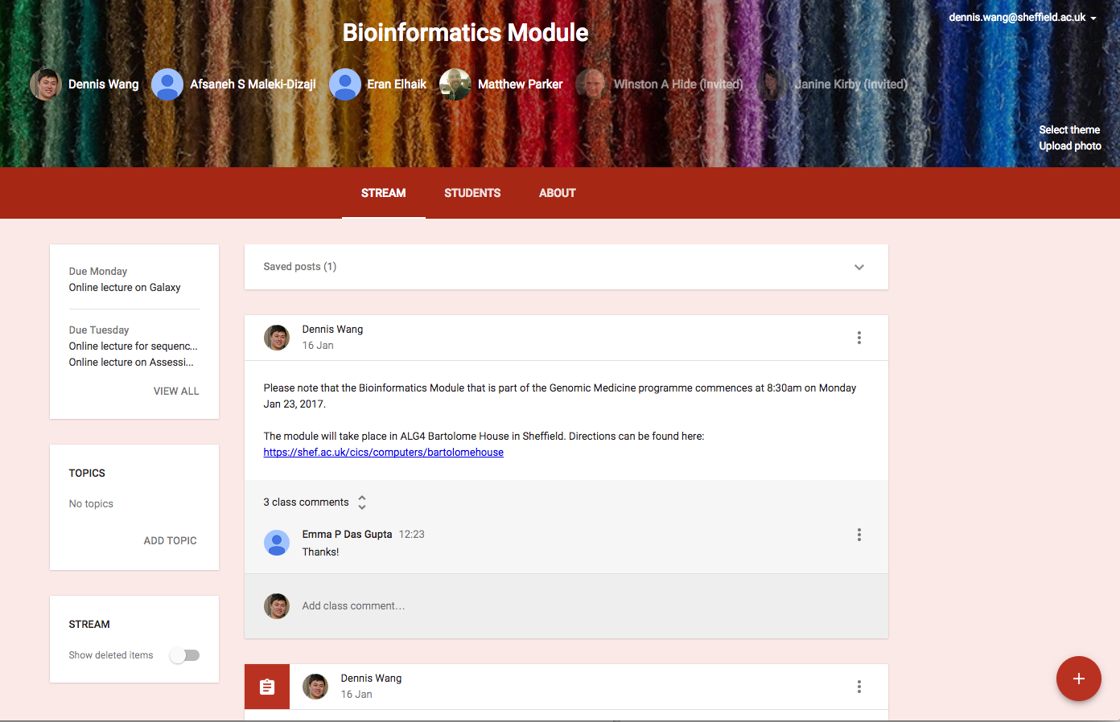
Questions & Discussions
https://classroom.google.com/

Slide 14
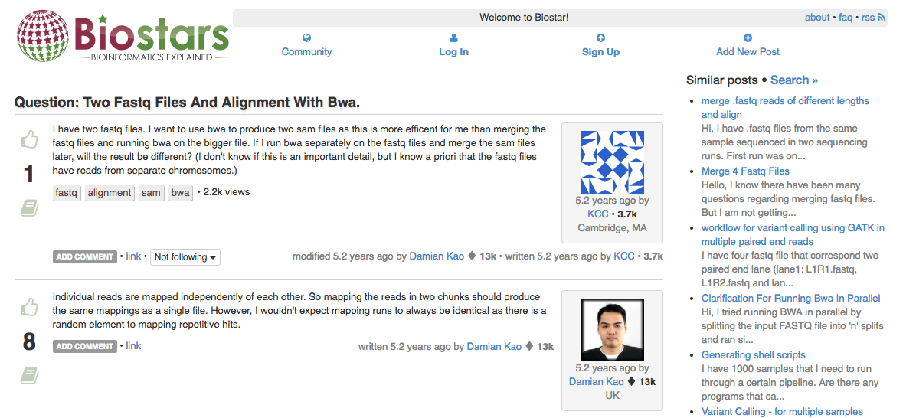
Bioinformatics community
www,biostars.org

Slide 15
Get today’s material
https://goo.gl/SCYTFV

